Slide 1

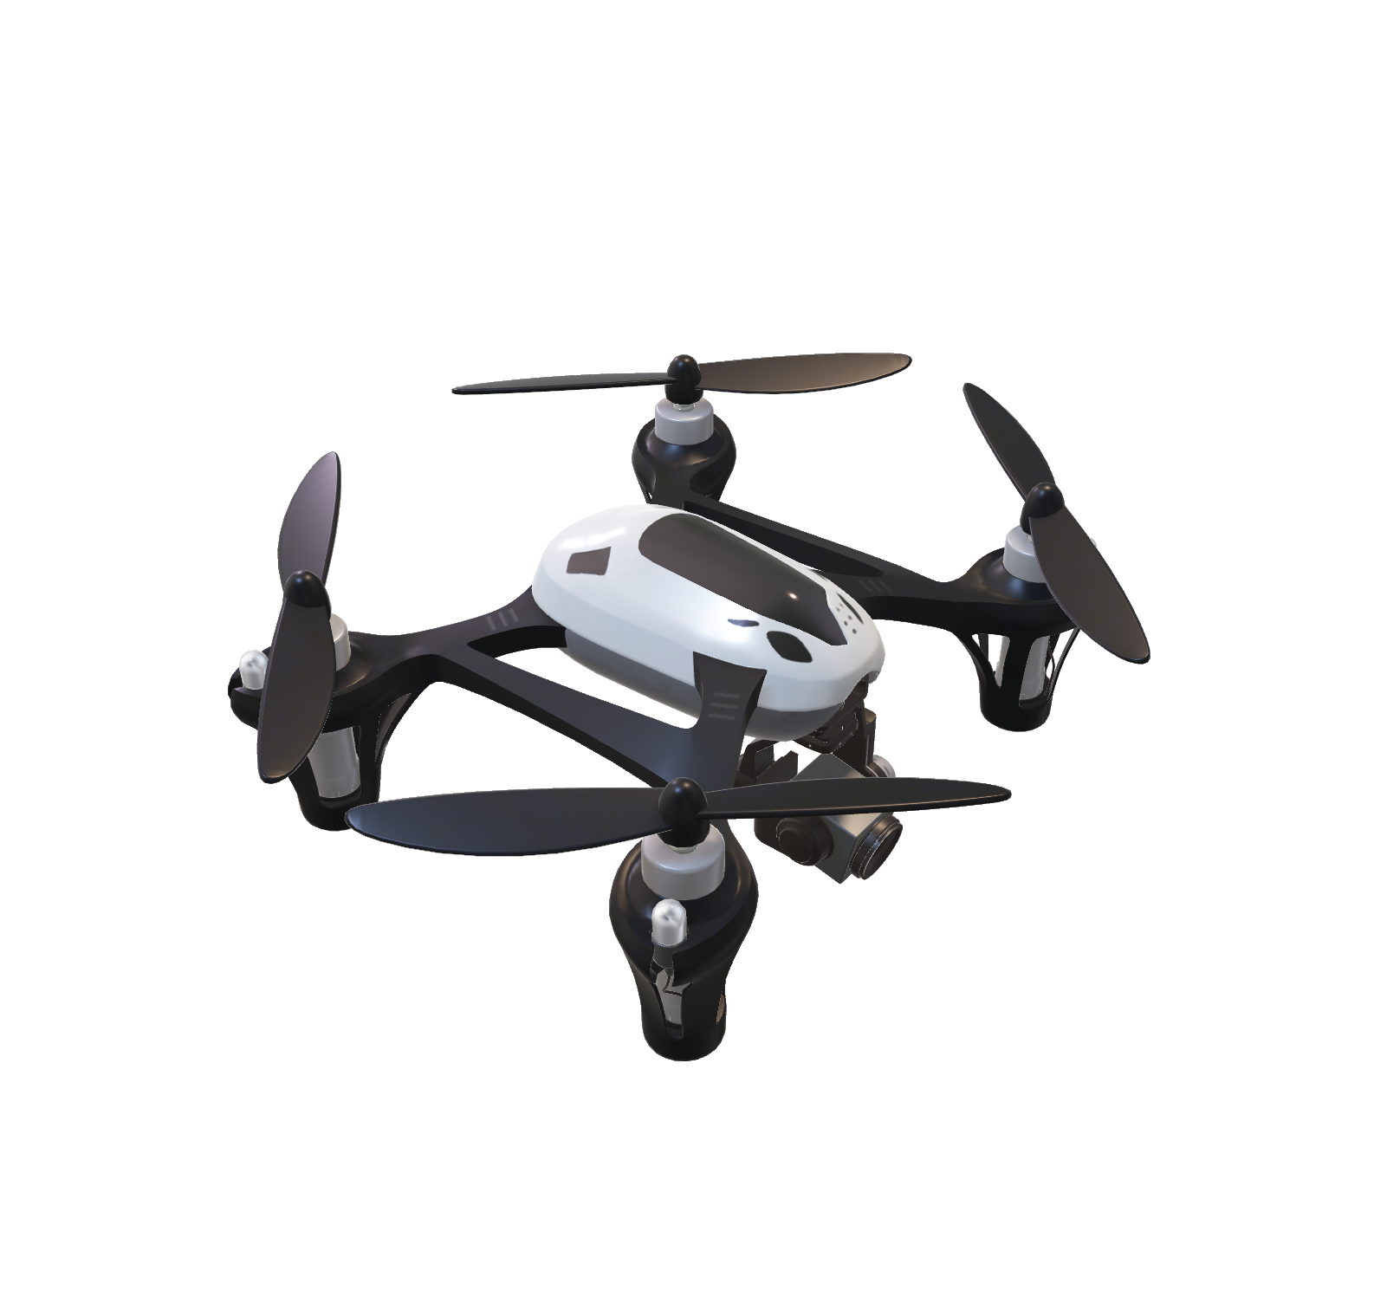
Contoso Mark 8
Creativity Unleashed

Slide 2

Elevated performance and fit
With an easy to use flight system, state of the art camera, and more, the Contoso Mark 8 lets everyone elevate their creativity.
Long Range Control
Our latest technology has an effective transmission distance of up to 8.9mi while still delivering 1080p video and FPV views

Slide 3
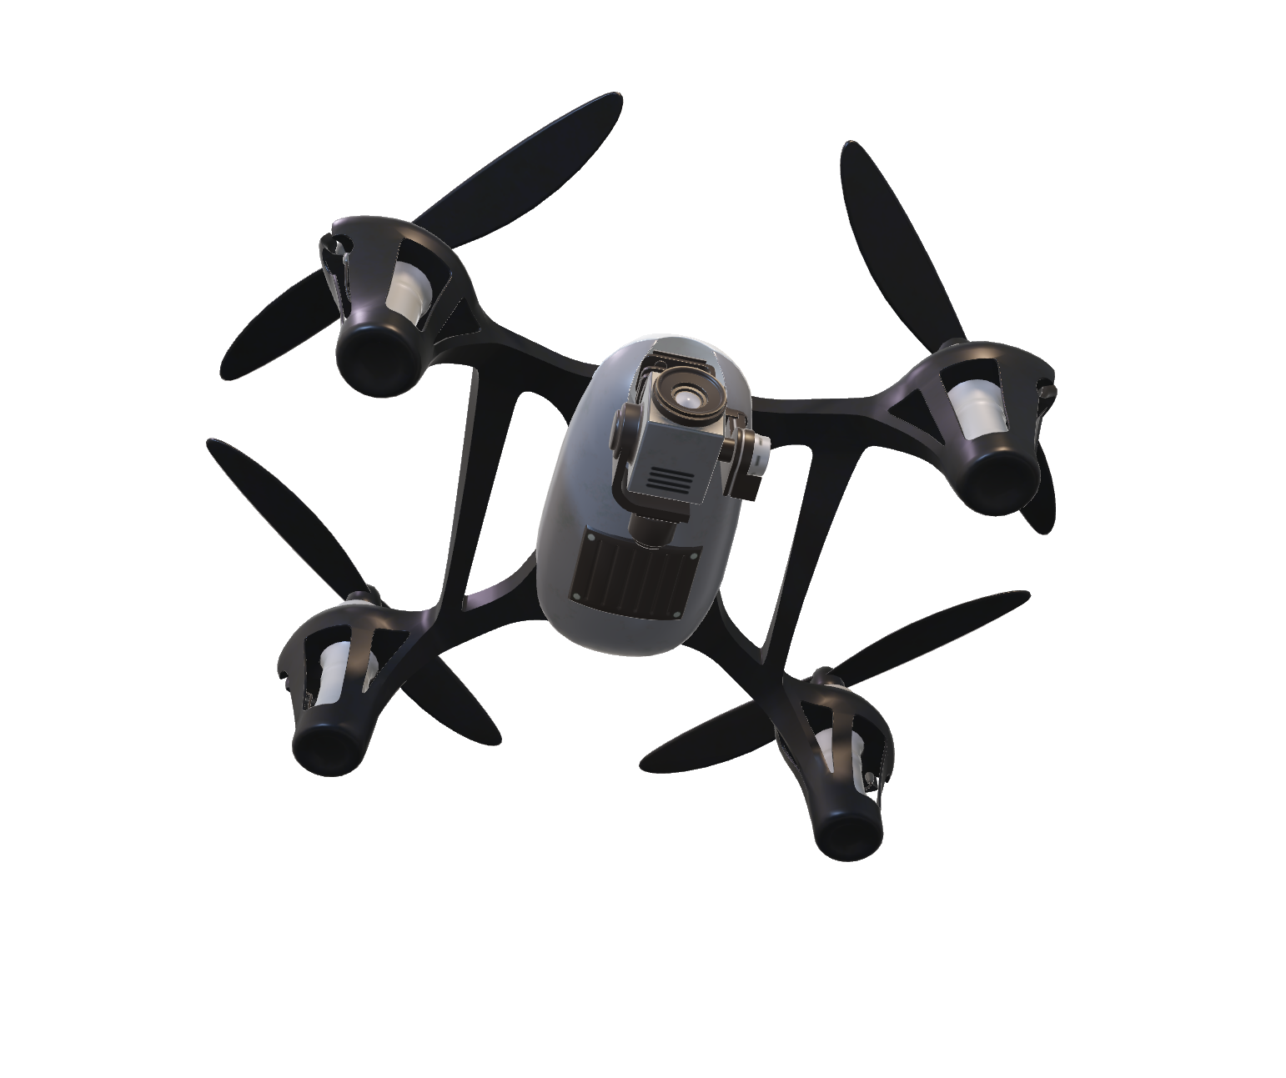
Elevated performance and fit
With an easy to use flight system, state of the art camera, and more, the Contoso Mark 8 lets everyone elevate their creativity.
Long Range Control
Our latest technology has an effective transmission distance of up to 8.9mi while still delivering 1080p video and FPV views

Slide 4

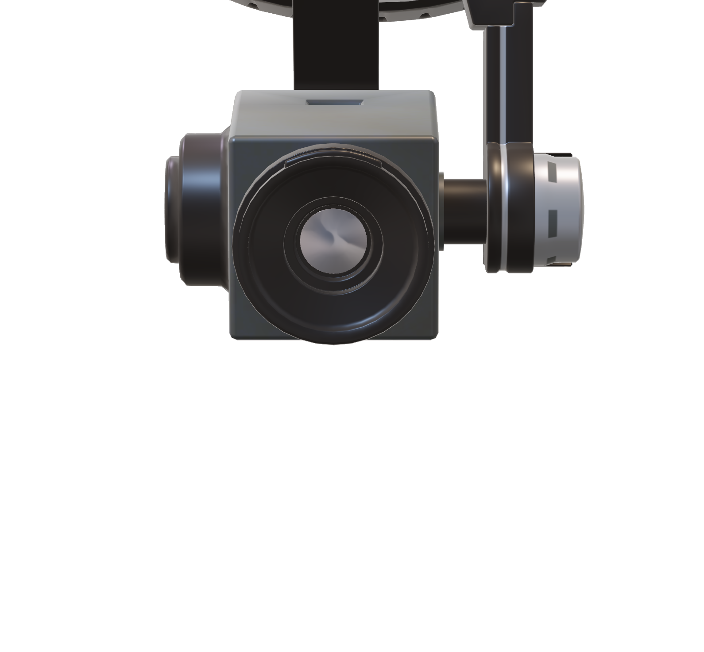
Improved performance and fit
A new camera with a 1-inch 25-megapixel sensor capable of shooting 4K video at 60fps and stills at a 20 fps Burst Mode.
Revolutionary Custom Lens
An industry first, custom engineered lens, with twelve elements, arranged in eight groups, can eliminate distortion of fast moving objects
Powerful as Many Cameras
Capture amazing detail with advanced video processing to support H.264 4K video at 60 fps with a 100Mbps bitrate..

Slide 5

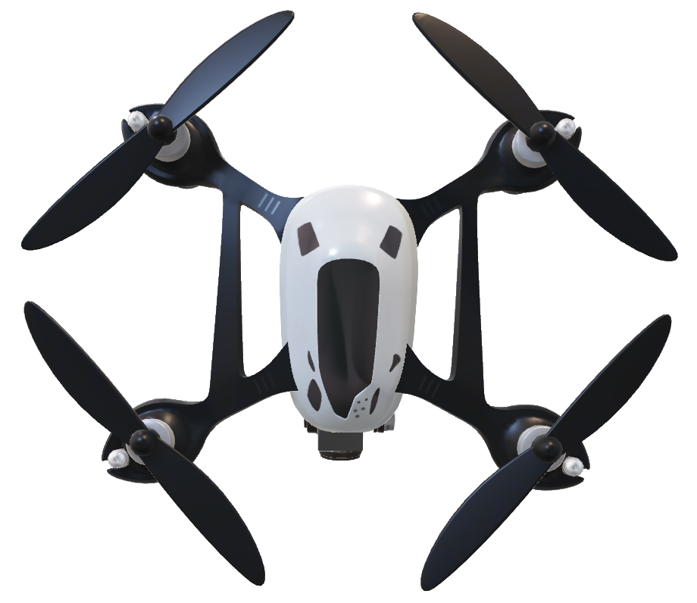
Avoid Obstacles
The Contoso dual rear vision sensors and infrared sensors combine with the autonomous flight system for a total of six-directions of obstacle sensing and avoidance
Greater strength
Using carbon fiber and magnesium alloy construction the Contoso Mark 8 not only is the lightest in it’s class but also the most rigid
Longer Flight Time
To shot amazing aerial images you need longer flight times. The Contoso Mark 8 has a flight time of up to 90 minutes.
Cloud Connected for Intelligence
Every flight your Contoso Mark 8 gets smarter and easer to operate thanks to it’s real time connection to the Microsoft Cloud and advanced machine learning algorithms.

